Slide 1







The AI Summit Hackathon
PENSIONVERSE
Presented by Team 7

Slide 2



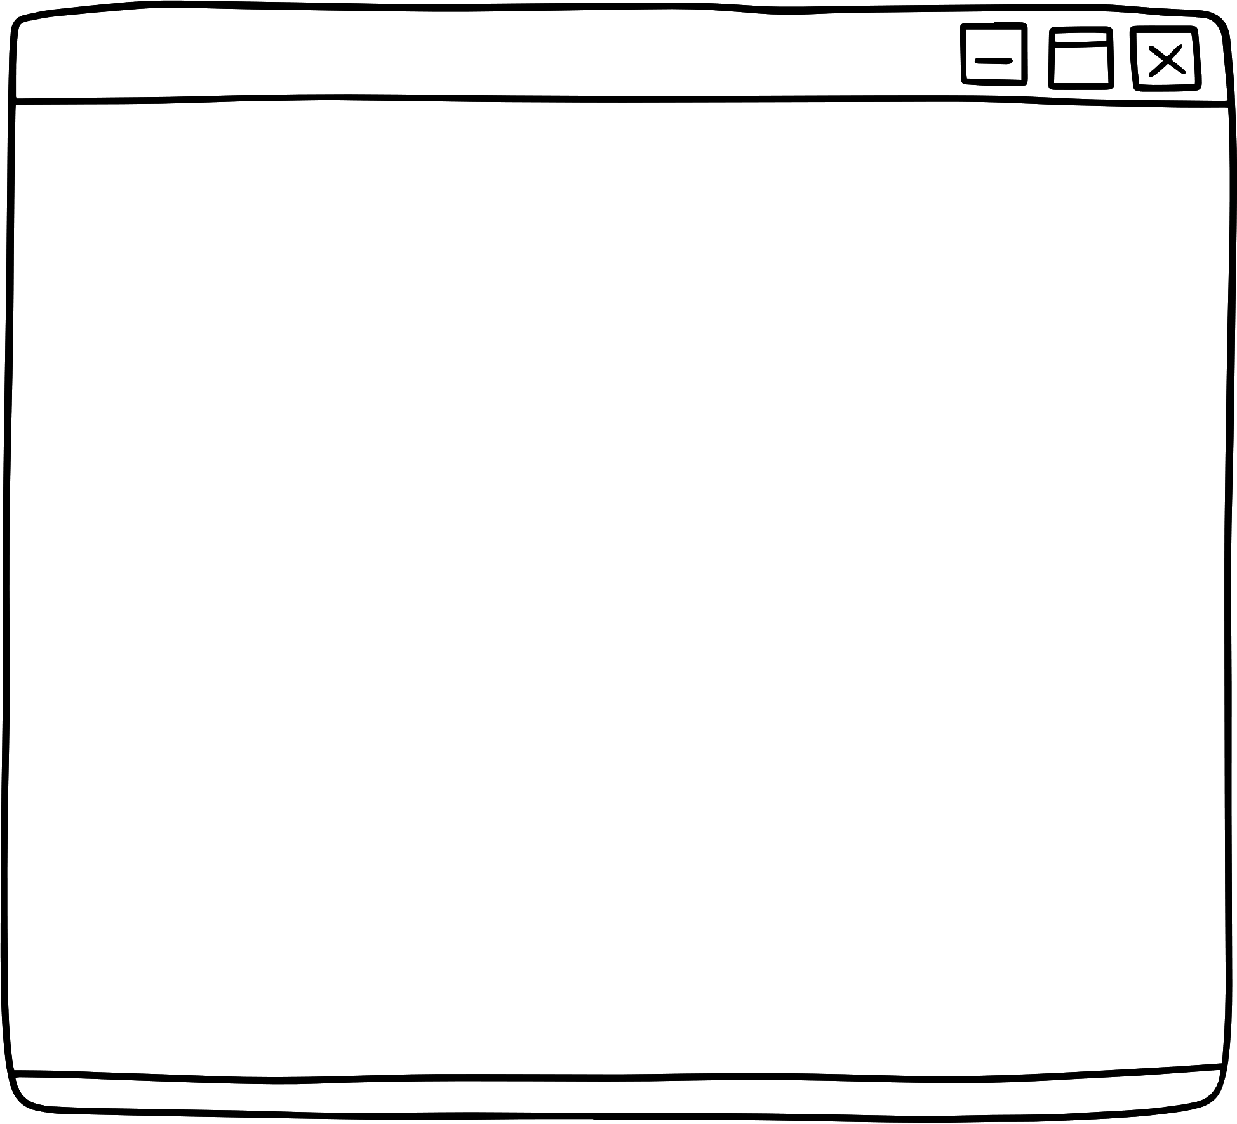

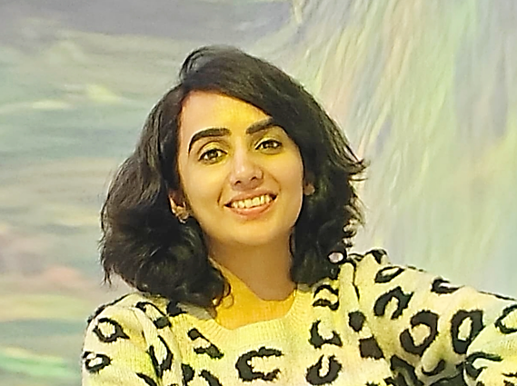
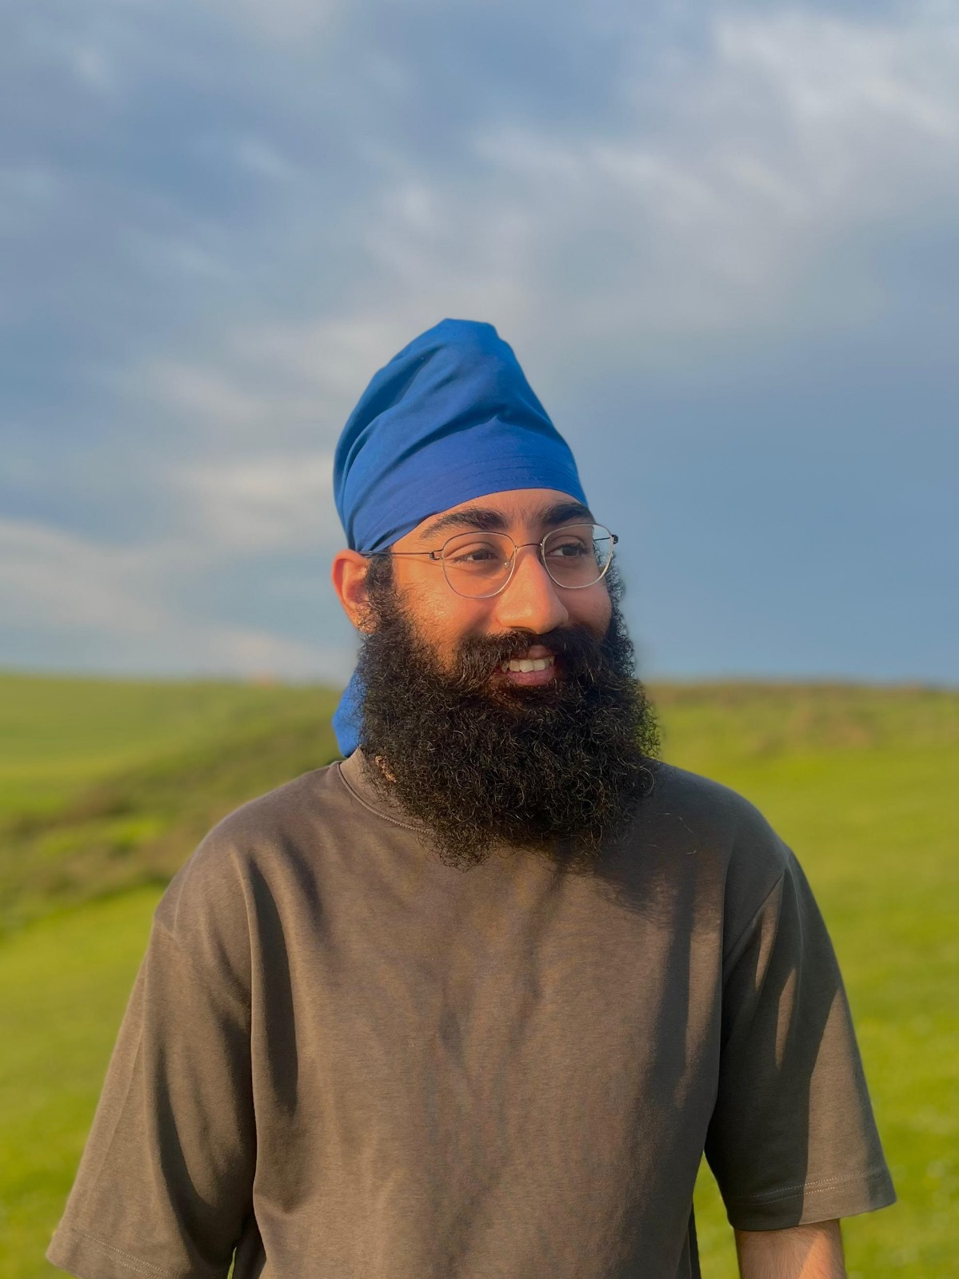
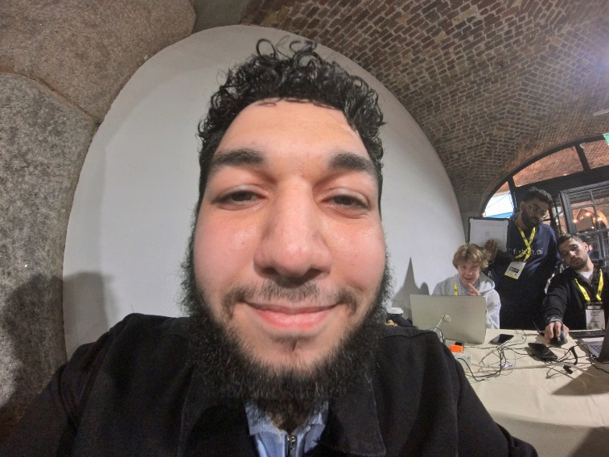
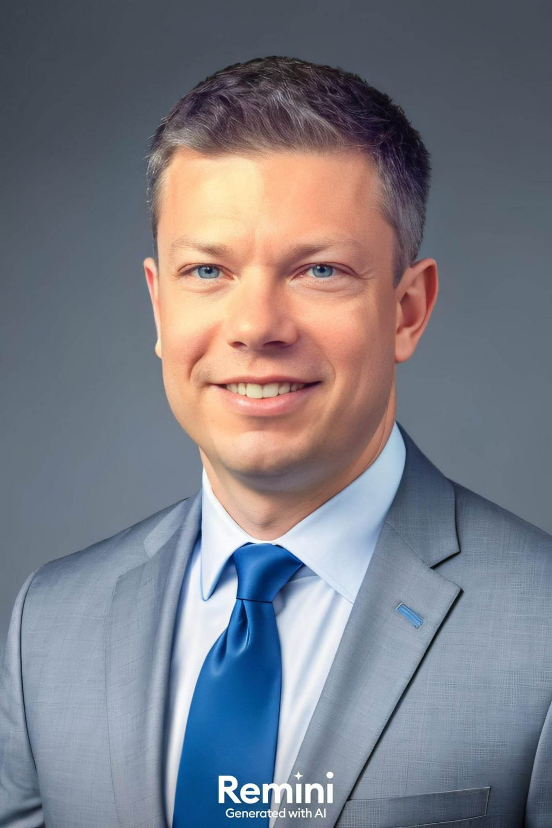

THE TEAM
Arpita Visen
Pavanpreet Gandhi
Abdurrahman Alsharef
Radek Kwasniak
Product Manager
Data Scientist
Software Developer
Computer Science Student

Slide 3


BOB HAS A PROBLEM
BOB HAS A PROBLEM
Bob is sad. He is feeling overwhelmed as administrative tasks pile up. He constantly finds himself manually matching clients to appropriate policies and recommending pricing based on lengthy and complex policy documents.

Slide 4



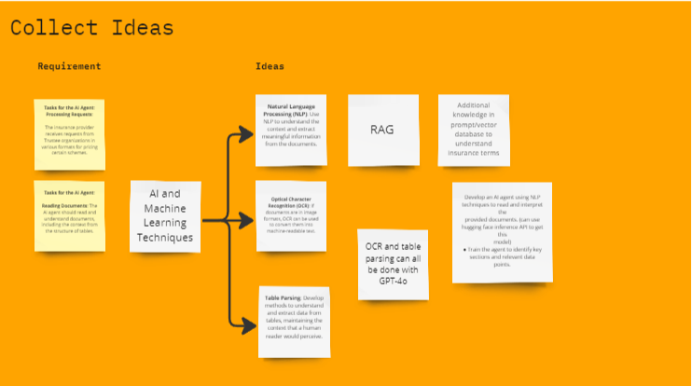

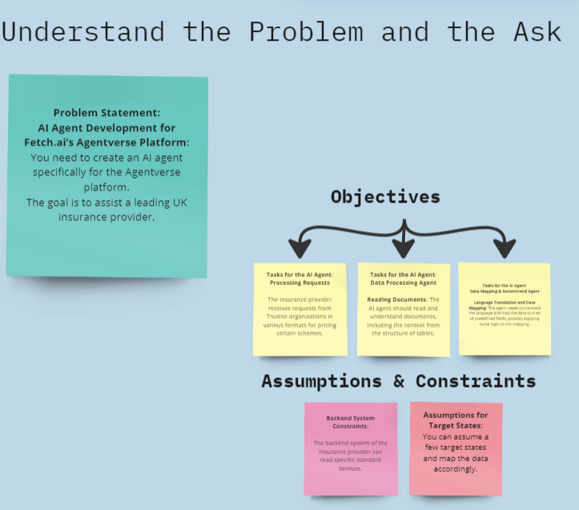

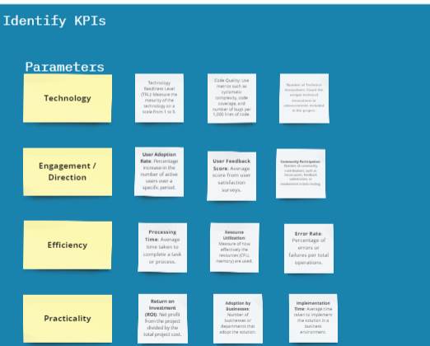
OUR APPROACH
Link: https://miro.com/app/board/uXjVK8n3xdA=/?share_link_id=85851867078
Notes:
The approach taken to address the challenges involved a collaborative and systematic process. Initially, the team worked together to understand the existing landscape and identify its challenges. This collaborative effort led to a clear definition and comprehension of the problem statement. The problem was then broken down into manageable components, allowing the team to tackle each issue systematically.
We conducted brainstorming sessions to generate potential solutions, and given the existing constraints and limitations, hypotheses were made to guide the technical decisions.
We produced three solutions and given the existing constraints and limitation developed upon one of them for which we mapped out the user journey.
To ensure efficient execution, each task was broken down into smaller tasks and distributed among team members. Throughout the process, communication channels were established to facilitate ongoing collaboration and discussions, ensuring alignment and progress. This structured approach ensured that the team could effectively address the challenges and develop a viable solution.
Our approach highlights:
Collaborated as a team to understand the existing landscape and its challenges.
Defined and understood the problem statement.
Broke down the problem statement to tackle issues individually.
Brainstormed and ideated potential solutions for the challenge.
Drafted hypotheses considering existing constraints and limitations, guiding our technical choices.
Created a solution and mapped out the user journey.
Divided features into smaller tasks and assigned them amongst the team.
Established communication channels for ongoing collaboration and discussions.

Slide 5


PROBLEM 1
The Legal & General (L&G) team receives bulk data from brokers and agents regarding customer pension requirements.
PROBLEMS
PROBLEM 2
The L&G receives pricing requests for certain schemes from trustee organizations. These requests are often difficult to understand and standardize.
The existing landscape and the challenges
PROBLEM 3
These documents requires the expertise of specialists to analyze and create rules for pricing suggestions which is a significant effort.

Slide 6





TASK 1
BREAKING DOWN BOB ’S PROBLEM
Document Analysis
Use AI agents to parse and understand PRT scheme documents.
TASK 2
Data Mapping:
Another set of AI agents to map the extracted information to specific fields required for backend processing.
TASK 3
Recommendation System:
Implement a rule-based or ML based system to analyze the mapped data and recommend suitable PRT schemes or pricing options.
Notes:
From the given challenge, we drafted three tasks or objectives to meet in order to solve the problem. This approach ensures that complex problems are broken down into manageable parts, allowing for focused and effective problem-solving.

Slide 7
IDEAS 1
Leverage the local and remote Large language models
BRAINSTORMING & IDEATION
IDEAS 2
Leverage Agentic architecture (e.g. semantic search and tools)
Note for future: We can leverage DSPy and AutoGen technologies in conjunction with ledger-based communication systems, integrating them into a framework that offers Agents as a Service for a more sophisticated solution.
IDEAS 3
Leverage Python interoperability (e.g. LLMs generating machine compatible formats)
Notes:
After identifying the three tasks that needed addressing, we collectively brainstormed on how we might solve the challenge. Other ideas which we discussed for a more sophisticated solution was around utilizing DSPy and AutoGen technologies in conjunction with ledger-based communication systems, integrating them into a framework that offers Agents as a Service. This approach aims to streamline and automate processes, enhance communication efficiency through ledger systems, and provide scalable agent-based services tailored to various applications and industries.

Slide 8

SOLUTION 1
Backend Journey only
BOB‘S UTOPIA
SOLUTION 2
Solution on deltav
The Goldie Locks Principal
SOLUTION 3
LLM OS on agentverse

Slide 9


DEFINING THE APPLICATION JOURNEY
Pension Scheme Details Document
Rules
Schema and price agent
Doc analysis agent
Output DB
Complete Customer DB
Filtered Customer DB
Schema and price agent
Schema agent
User Interface

Slide 10



TECHNICAL DECISIONS
REASON 1
LLMs are capable to reasoning very well on natural language documents. They are more than just token predictors as they have reasoning capabilities.
REASON 2
Agent 1 uses an LLM with RAG and semantic search capabilities to extract a clear set of rules from the provided document
RAG and Semantic search allows us to be targeted in the information we collect from the document, resulting in better accuracy.

Slide 11
TECHNICAL DECISIONS
REASON 1
Schemas are often stored in JSON which is a computer readable format but also easy for humans (and for that matter LLMs) to understand.
REASON 2
The JSON output from an LLM can be parsed using Python code, facilitating seamless interoperability between LLMs and rule-based systems, such as database column filtering. Future enhancements in this area could involve DSPy.
LLM to modify a schema (in JSON format) based on the provided set of rules from agent 1

Slide 12
TECHNICAL DECISIONS
REASON 1
The LLM is chosen to run locally since we can maintain the privacy of users data. The price analysis can be done with a API call to a more powerful LLM for better reasoning capabilities.
Agent 3 runs on a local LLM. It takes in the rules and data of people and outputs the scheme analysis and price.
REASON 2
A future improvement could be to use an AI firewall to prevent any risk of PII leaking through the output of the local LLM since LLMs can be unreliable.

Slide 13


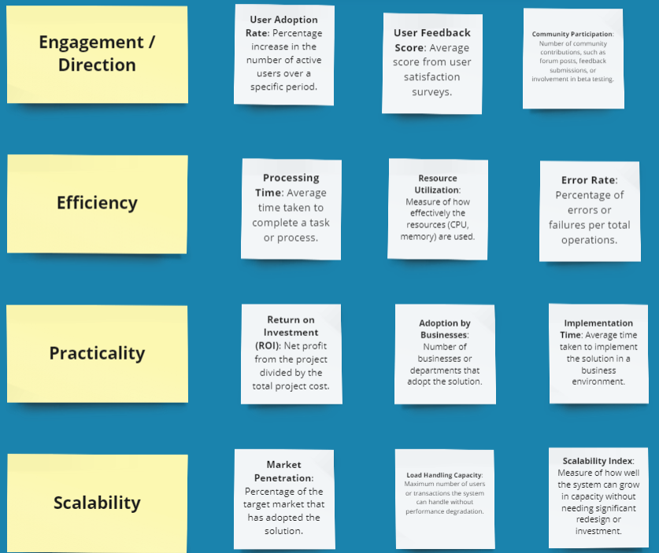

DEFINING & MEASURING OUR KPIS
Metrics
Link: https://miro.com/app/board/uXjVK8n3xdA=/?share_link_id=85851867078

Slide 14





Agent 1
DEMO
Agent 2
Lights. Camera. Action
Agent 3

Slide 15


CALL TO ACTION
A FEW POINTERS FOR SCALABILITY*
DSPy Integration, AI firewall. More general agents for contributing to fetch.ai ecosystem and more powerful local LLMs.
*(HOW TO MAKE BOBS LIFE EASIER)
Chatbot for individual users to confidentially find out how their pricing might change in certain situations.
Validate and improve prompt and flow architecture.

Slide 16


REACH OUT TO US!
arpitavisen9@gmail.com
pavanpreet.gandhi@gmail.com
radek.kwasniak@gmail.com
abdurrahmanalsharefnu@gmail.com
Q&A TIME

